Slide 1
5
Functions
Objectives
In this chapter, you’ll:
Construct programs modularly from small pieces called functions.
Use common math functions from the C standard library.
Create new functions.
Understand how function prototypes help the compiler ensure that you use functions correctly.
Use the mechanisms that pass information between functions.
See some commonly used C standard library headers.
Learn how the function call and return mechanism is supported by the function-call stack and stack frames.
Build a casino game using simulation techniques and random-number generation.
Understand how an identifier’s storage class affects its storage duration, scope and linkage.
Write and use recursive functions, i.e., functions that call themselves.
Continue our presentation of Secure C programming with a look at secure random-number generation.

Slide 2
5.1 Introduction
Most computer programs that solve real-world problems are much larger than those presented in the first few chapters.
Experience has shown that the best way to develop and maintain a program is to construct it from smaller pieces, each of which is more manageable than the original program.
This technique is called divide and conquer.

Slide 3
5.2 Modularizing Programs in C
In C, you use functions to modularize programs by combining the new functions you write with prepackaged C standard library functions.
The C standard library provides a rich collection of functions for performing common mathematical calculations, string manipulations, character manipulations, input/output and many other useful operations.
Avoid Reinventing the Wheel
Familiarize yourself with the rich collection of C standard library functions to help reduce program-development time.
When possible, use standard functions instead of writing new ones.

Slide 4
5.2 Modularizing Programs in C
Defining Functions
Functions are invoked by a function call, which specifies the function name and provides information (as arguments) that the function needs to perform its designated task.
A common analogy for this is the hierarchical form of management. A boss (the calling function or caller) asks a worker (the called function) to perform a task and report back when it’s done.
Function printf displays the data and reports back—or returns—to the caller when it completes its task.

Slide 5
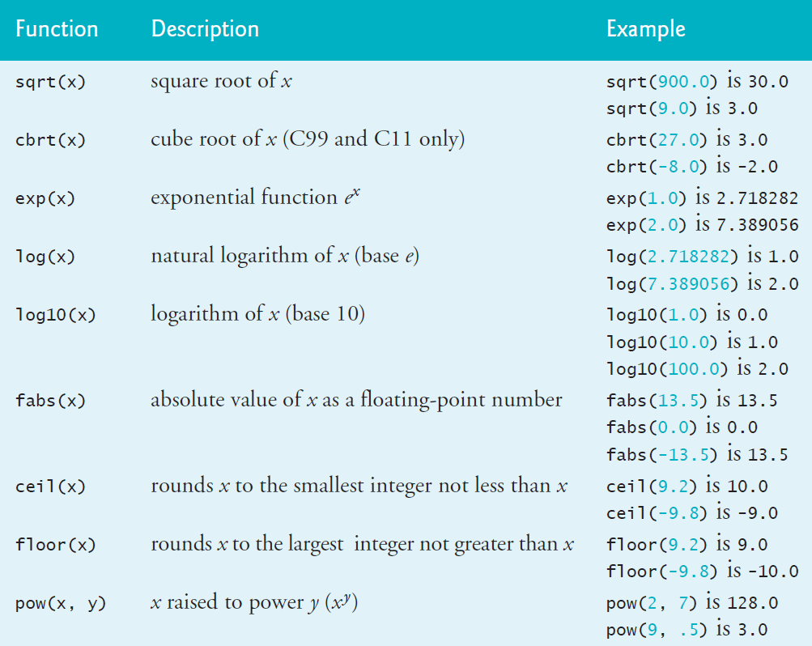
5.3 Math Library Functions
C’s math library functions (header math.h) allow you to perform common mathematical calculations.
We use many of these functions in this section.
To calculate and print the square root of 900.0 you might write
printf("%.2f", sqrt(900.0));

Slide 6
5.4 Functions
Functions allow you to modularize a program. In programs containing many functions, main is often implemented as a group of calls to functions that perform the bulk of the program’s work.
Functionalizing Programs
There are several motivations for “functionalizing” a program. The divide-and-conquer approach makes program development more manageable.
Another motivation is building new programs by using existing functions. Such software reusability is a key concept in object-oriented programming languages derived from C, such as
C++,
Java,
C# (pronounced “C sharp”),
Objective-C and
Swift.

Slide 7
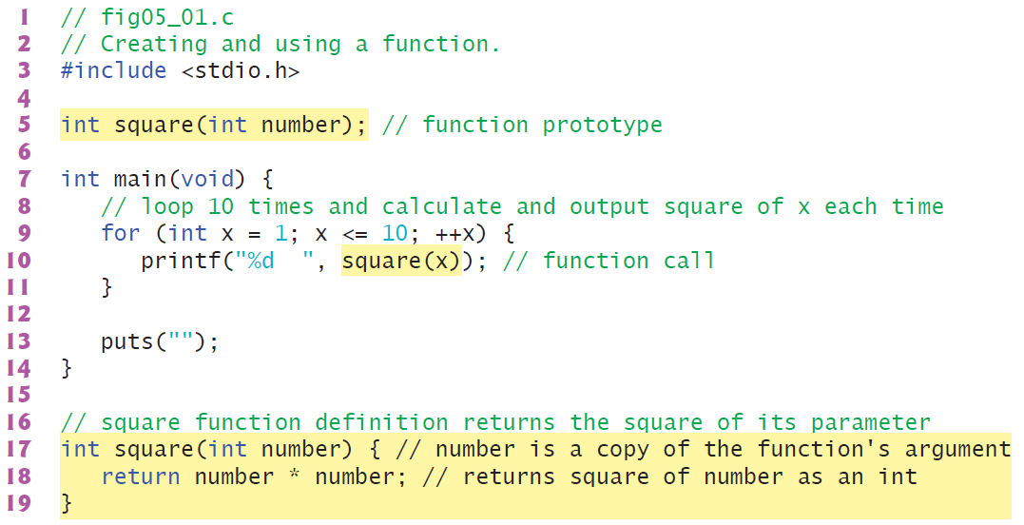
5.5 Function Definitions
Each program we’ve presented has consisted of a function called main that called standard library functions to accomplish its tasks. Now we consider how to write custom functions.
5.5.1 square Function
Consider a program that uses a function square to calculate and print the squares of the integers from 1 to 10

Slide 8
5.5 Function Definitions
Calling Function square
Function square is invoked or called in main within the printf statement (line 10):
Function square receives a copy of the argument x’s value in the parameter number (line 17).
square Function Definition
Function square’s definition (lines 17–19) shows that it expects an int parameter number.
The keyword int preceding the function name (line 17) indicates that square returns an integer result.
The return statement in square passes the result of number * number back to the calling function.

Slide 9
5.5 Function Definitions
Local Variable
All variables defined in function definitions are local variables—they can be accessed only in the function in which they’re defined.
Most functions have parameters that enable communicating between functions via arguments in function calls.
A function’s parameters are also local variables of that function.
Format of a Function Definition
The format of a function definition is
return-value-type function-name(parameter-list) {
statements
}
The function-name is any valid identifier. The return-value-type is the type of the result returned to the caller. The return-value-type void indicates that a function does not return a value. Together, the return-value-type, function-name and parameter-list are sometimes referred to as the function header.

Slide 10
5.5 Function Definitions
Local Variable
All variables defined in function definitions are local variables—they can be accessed only in the function in which they’re defined.
Most functions have parameters that enable communicating between functions via arguments in function calls.
A function’s parameters are also local variables of that function.
Format of a Function Definition
The format of a function definition is
return-value-type function-name(parameter-list) {
statements
}
The function-name is any valid identifier. The return-value-type is the type of the result returned to the caller. The return-value-type void indicates that a function does not return a value. Together, the return-value-type, function-name and parameter-list are sometimes referred to as the function header.

Slide 11
5.5 Function Definitions
Function Body
The statements within braces form the function body, which also is a block. Local variables can be declared in any block, and blocks can be nested. Functions cannot be nested—defining a function inside another function is a syntax error.
Returning Control from a Function
There are three ways to return control from a called function to the point at which a function was invoked. If the function does not return a result, control is returned simply when the function-ending right brace is reached, or by executing the statement
return;
If the function does return a result, the statement
return expression;
returns the expression’s value to the caller.

Slide 12
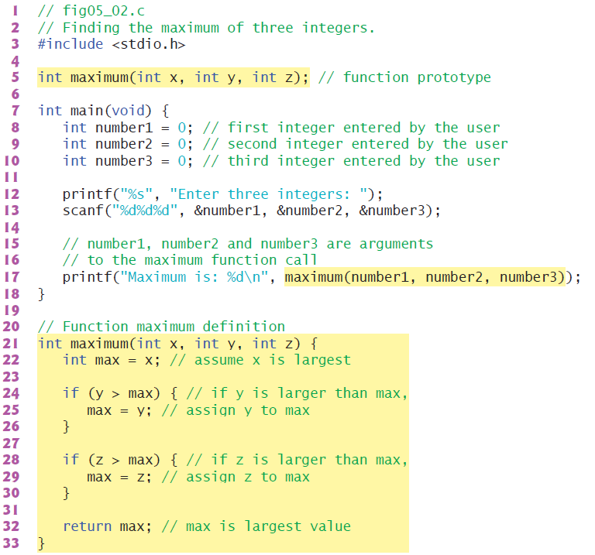
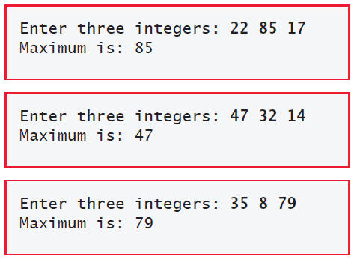
5.5 Function Definitions
5.5.2 maximum Function

Slide 13
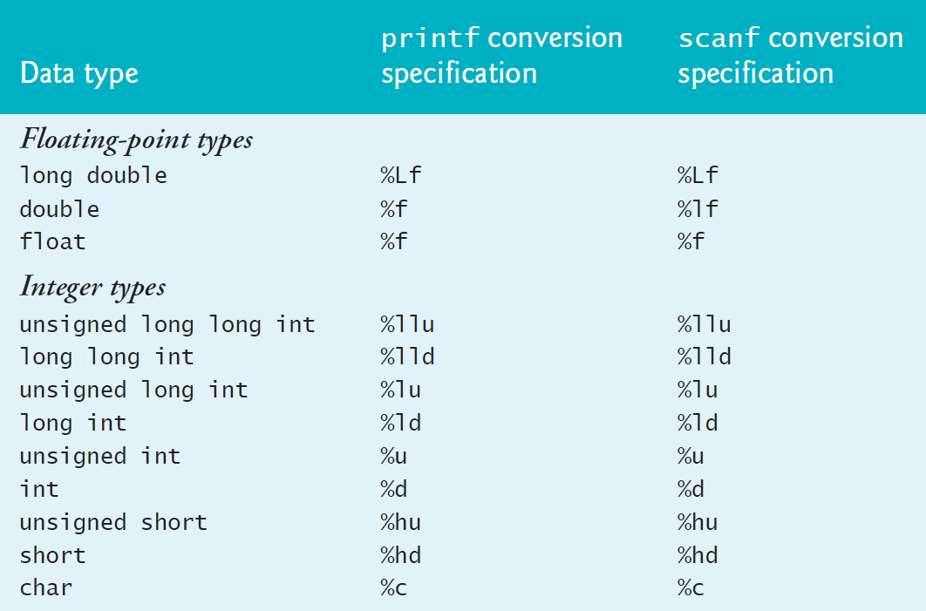
Mixed-Type Expressions

Slide 14
5.7 Function-Call Stack and Stack Frames
To understand how C performs function calls, we first need to consider a data structure (i.e., collection of related data items) known as a stack. Think of a stack as analogous to a pile of dishes.
You usually place a dish at the top—referred to as pushing the dish onto the stack.
Similarly, you typically remove a dish from the top—referred to as popping the dish off the stack.
Stacks are known as last-in, first-out (LIFO) data structures—the last item pushed (inserted) on the stack is the first item popped (removed) from the stack.

Slide 15
5.7 Function-Call Stack and Stack Frames
To understand how C performs function calls, we first need to consider a data structure (i.e., collection of related data items) known as a stack. Think of a stack as analogous to a pile of dishes.
You usually place a dish at the top—referred to as pushing the dish onto the stack.
Similarly, you typically remove a dish from the top—referred to as popping the dish off the stack.
Stacks are known as last-in, first-out (LIFO) data structures—the last item pushed (inserted) on the stack is the first item popped (removed) from the stack.

Slide 16
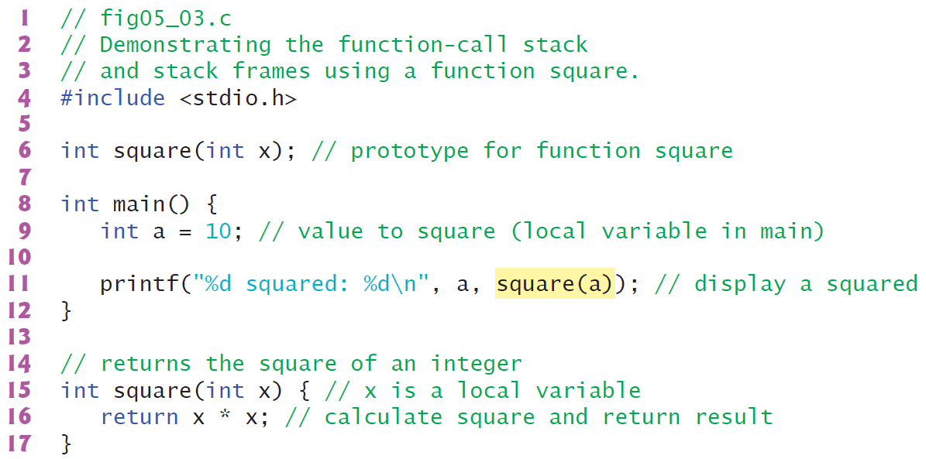
5.7 Function-Call Stack and Stack Frames

Slide 17
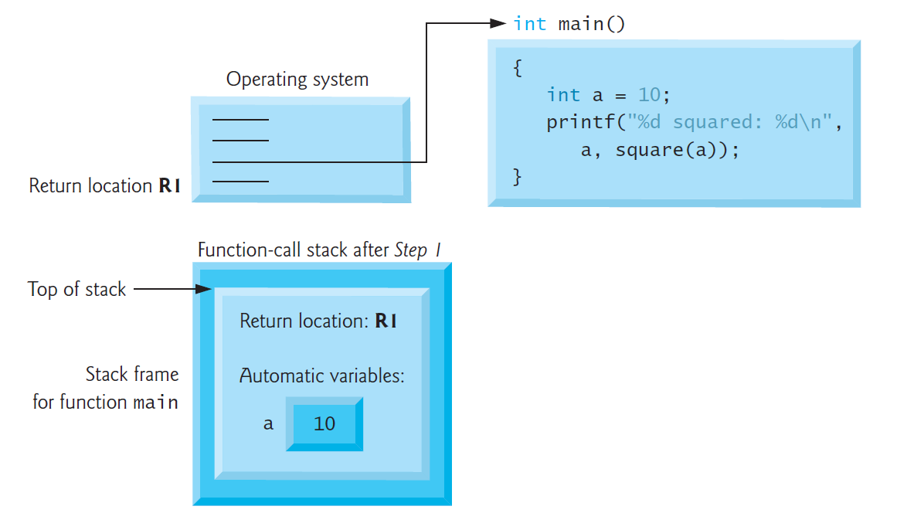
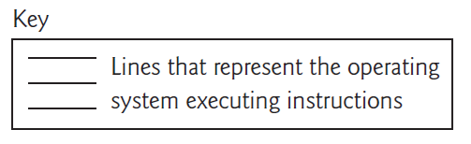
5.7 Function-Call Stack and Stack Frames
Step 1: Operating System Invokes main to Execute Application

Slide 18
5.7 Function-Call Stack and Stack Frames
Step 1: Operating System Invokes main to Execute Application

Slide 19
5.7 Function-Call Stack and Stack Frames
Step 1: Operating System Invokes main to Execute Application

Slide 20
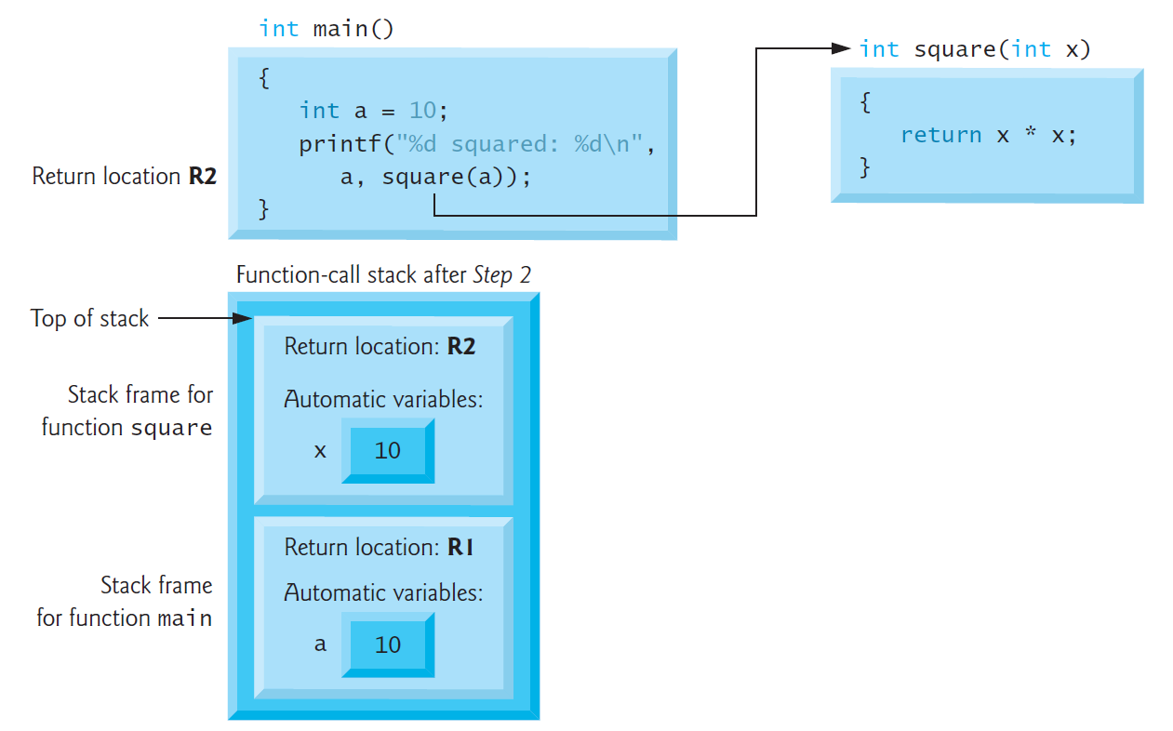
5.7 Function-Call Stack and Stack Frames
Step 2: main Invokes Function square to Perform Calculation

Slide 21
5.7 Function-Call Stack and Stack Frames
Step 2: main Invokes Function square to Perform Calculation

Slide 22
5.7 Function-Call Stack and Stack Frames
Step 2: main Invokes Function square to Perform Calculation

Slide 23
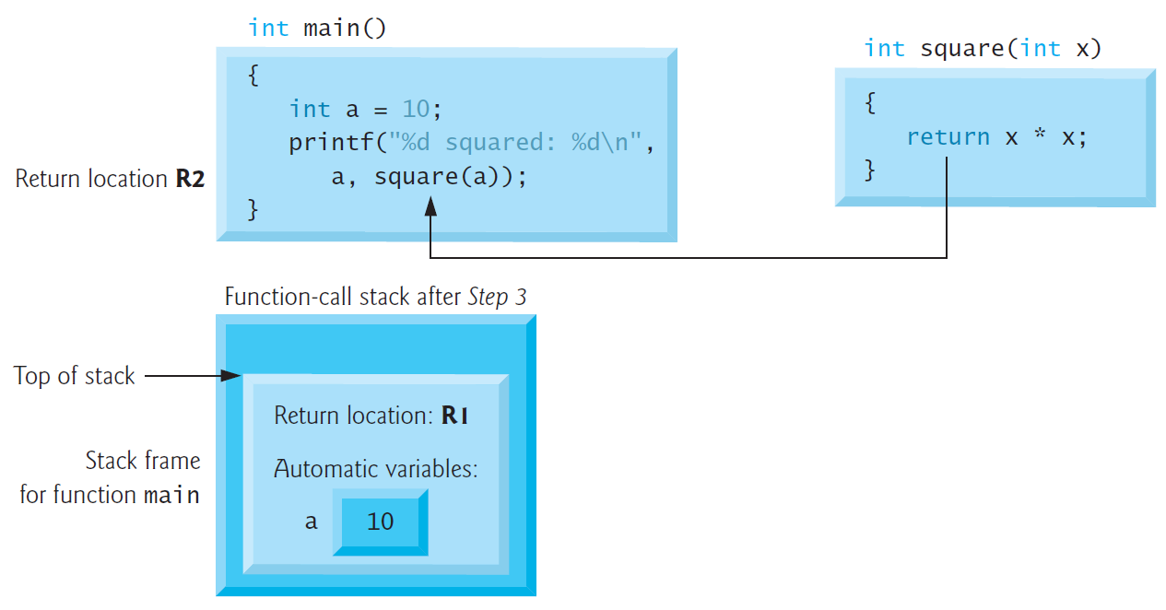
5.7 Function-Call Stack and Stack Frames
Step 3: square Returns Its Result to main

Slide 24
5.7 Function-Call Stack and Stack Frames
Step 3: square Returns Its Result to main

Slide 25
5.7 Function-Call Stack and Stack Frames
Step 3: square Returns Its Result to main

Slide 26
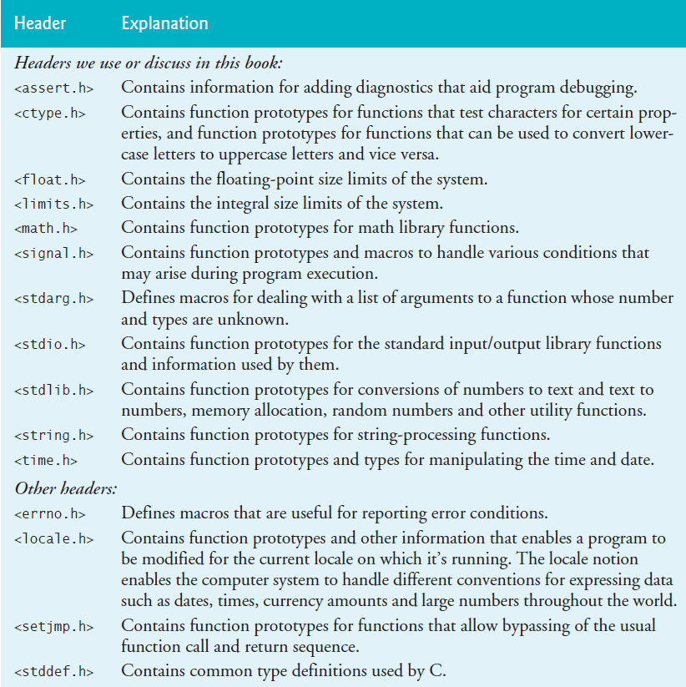
5.8 Headers

Slide 27
5.8 Headers

